Slide 2
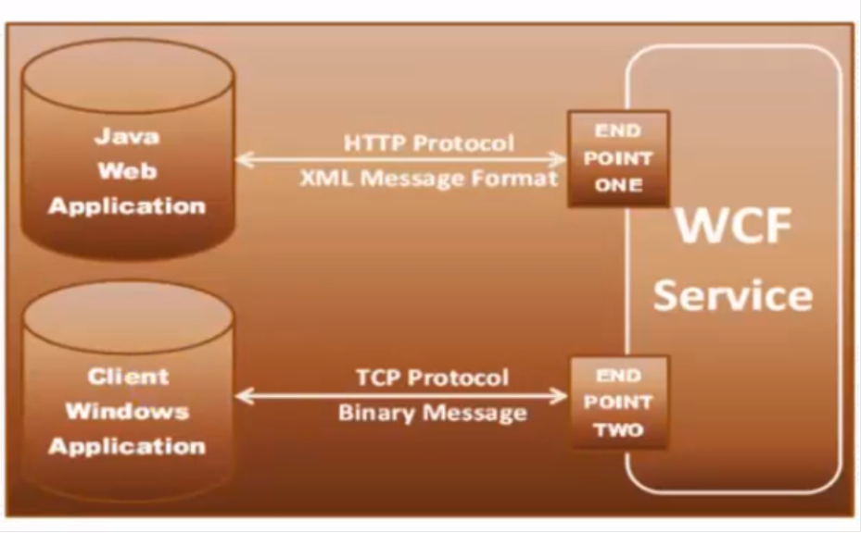
WCF service
Windows communication foundation
WCF is Microsoft platform for building distributed and interoperable application

